Slide 1
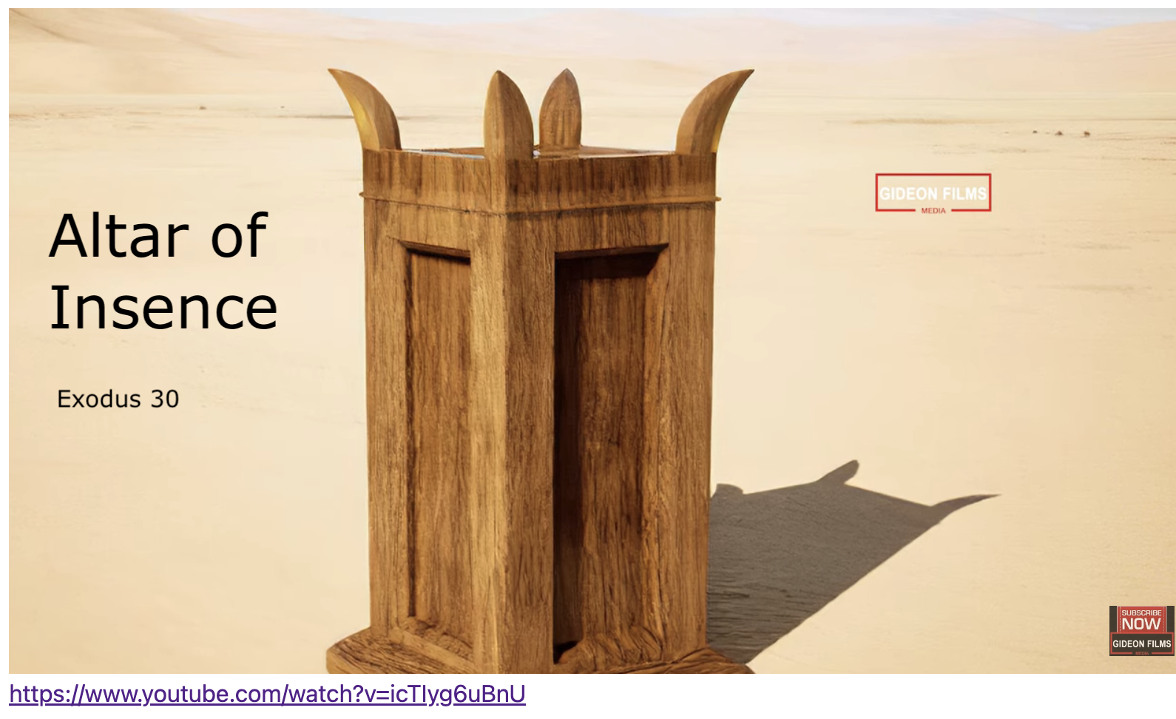
Exodus 出埃及記 30:01-10 The Altar of Incense
親子靈修 William分享
09-13-2025

Slide 2
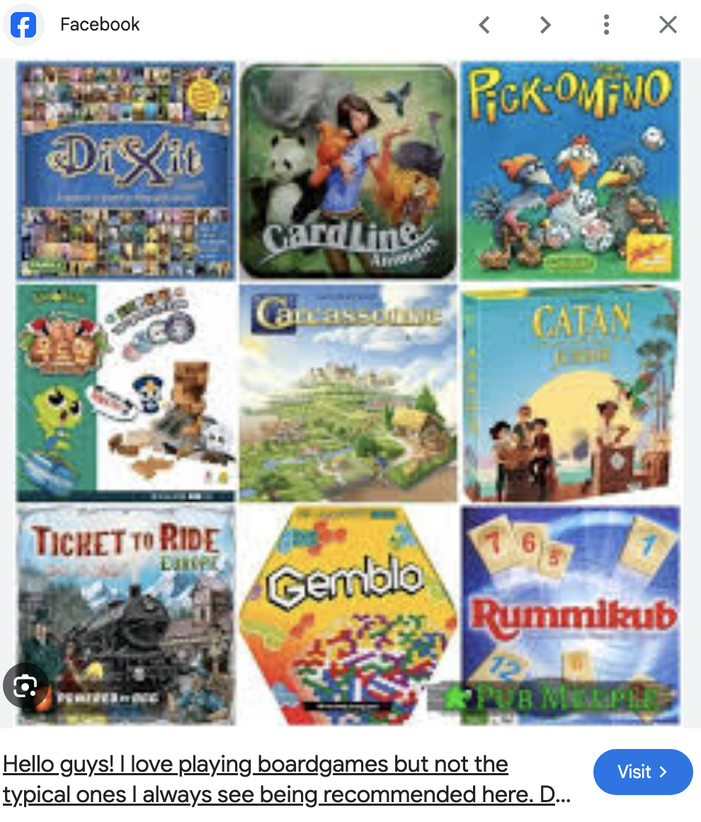
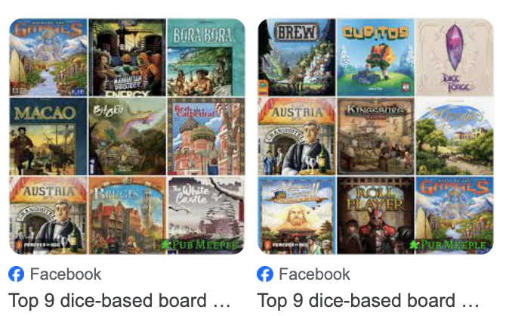
To Children: What is your favorite game?

Slide 3
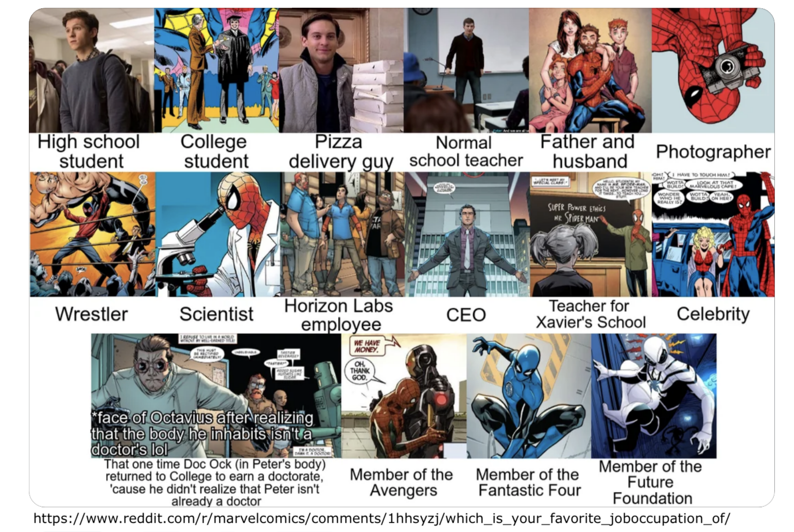
To Parents: What is your favorite job/occupation?

Slide 4
What is the significance of your favorites?
What makes your favorite?
Fun.
Kill Time.
Curiosity.
…
Meaningless.
I don’t know.
Earn money to support the family.
…

Slide 5
https://www.youtube.com/watch?v=icTIyg6uBnU English Version Video: Exodus 30:01-10.
(1 min)

Slide 6
What is incense (香)?
Incense is any material, typically fragrant plant matter, that produces aromatic smoke when burned.
What is Altar (坛)?
An altar is a table or flat-topped block used as the focus for a religious ritual, especially for making sacrifices or offerings to God.
What is the Altar of Incense (香坛)?
An altar of Incense is an altar for priests to burn incense to symbolize prayers ascending to God.

Slide 7
Would you like to build an Altar of Incense?
Yes, I’d love to.
No, it’s boring.
No, I don’t like it.
No, I don’t know how to do it.
No, I don’t know the meaning of doing it.
…

Slide 8
What is the Significance of Building the Altar of Incense?
Golden Verse: Exodus 32:6. This is what God Said:
"要把坛放在法柜前的幔子外、对着法柜上的施恩座、就是我要与你相会的地方。" (Exo30:6 CUVS)
"Put the altar in front of the curtain that is before the ark of the Testimony before the atonement cover that is over the Testimony - where I will meet with you." (Exo30:6 NIV)

Slide 9
個人反思 & 教養智慧
個人反思 Personal Reflection：
How to build an altar of incense in our family in modern times?
教養智慧：
"至于我、和我家、我们必定事奉耶和华。" (Jos24:15 CUVS)
"as for me and my household, we will serve the Lord ." (Jos24:15 NIV)

Slide 10
Closing Prayer
Dear Heavenly Father, the Glorious Lord, the Creator, and Sovereign of all things. Thank you for your mercy and grace. Thank you for calling us, the parents. Thank you for giving us, the parents, the educational authority. Our children are your heritage. We are the sinners; we do not deserve it. May Your Holy Spirit call us, guide us. Bless our children and young generation to be able to know you, follow you to be the devotional generation. May your name be glorified, generation by generation, and forever. I pray in the name of Jesus. Amen.

Slide 11
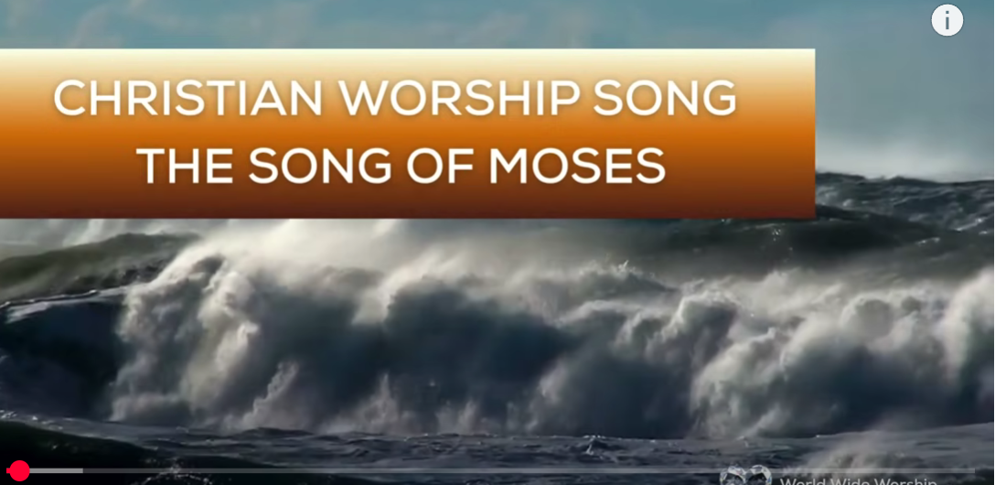
1.No Turning Back
https://www.youtube.com/watch?v=yNtid3wdDWA&list=RDyNtid3wdDWA&start_radio=1&ab_channel=GaiseBaba
Christian Kids
https://www.youtube.com/watch?v=7vihn5MpWSc&list=RD7vihn5MpWSc&start_radio=1
2. The Song of Moses https://www.youtube.com/watch?v=a-wWKL-7Mrg
The Song of Moses Like You've Never Heard Before | Christian Worship Song/ World Wide Worship

